Slide 1
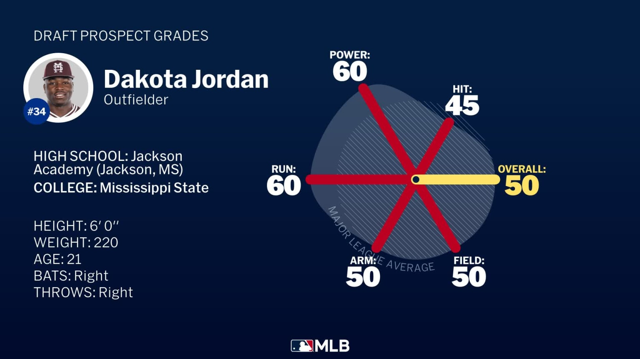
MLB Prospect Predictor Created by Chase Bender
Baseballs Future, Powered by Stats
Takes stats of players and uses formulas to predict that players future success
Uses the 20-80 scale and both common and advanced stats / metrics

